Slide 1


Customer Churn Prediction
Machine Learning Project
Presented by: Amey Mahesh Gode
Dilkap Research Institute of Engineering and Management Studies
AI & Machine Learning Engineering

Slide 2

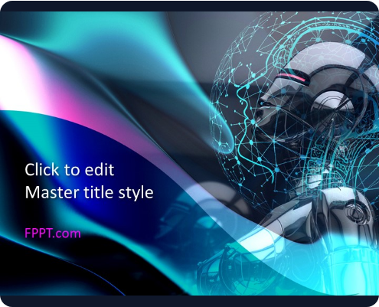
Project Overview
▹
Definition: Customer churn signifies when a customer stops using a company's products or services.
▹
Primary Goal: To proactively predict which current customers are highly likely to churn in the near future.
▹
Methodology: Advanced Machine Learning techniques are leveraged to discover complex patterns within historical customer datasets.
▹
Deployment: The final trained predictive model is deployed as an accessible, interactive Streamlit web application.

Slide 3
Problem Statement & Objectives
The Core Problem: Telecom companies face significant revenue loss due to customer attrition driven by various factors like contract types, high charges, and service quality.
Objective 1: Accurately predict potential customer churn to enable proactive retention strategies.
Objective 2: Thoroughly analyze customer-related features to understand primary churn drivers.
Objective 3: Train, evaluate, and systematically compare multiple ML classification algorithms.
Objective 4 & 5: Select the highest-performing model, serialize it, and deploy it using a Streamlit web interface.

Slide 4

Dataset Details
Source Dataset: Telco Customer Churn dataset, providing a comprehensive historical view of telecom users.
Data Scope: The dataset encompasses detailed customer demographics, active service subscriptions, and account billing information.
Key Features: Critical predictors include customer tenure, contract type, internet service provider, payment method, and monthly/total charges.
Target Variable: Churn (Yes = customer churned, No = customer stayed).

Slide 5









Data Preprocessing & EDA
1. Data Cleaning
2. Exploratory Analysis
3. Feature Engineering
Loaded and systematically inspected the dataset using Pandas. Handled missing or invalid values and removed unnecessary unique customer identifiers to prevent model bias.
Utilized comprehensive EDA techniques and visual plots to uncover underlying churn patterns, feature correlations, and data distributions across different customer segments.
Separated independent features (X) from the target variable (y). Applied robust encoding to categorical variables and meticulously scaled numerical features for optimal model training.

Slide 6


Machine Learning Models
Logistic Regression & Decision Tree
Random Forest & K-Nearest Neighbors
Logistic Regression: Utilized as the primary baseline classification model to establish initial linear predictive performance and interpretability.
Random Forest: An advanced ensemble method combining multiple decision trees to significantly reduce overfitting and improve overall generalizability.
Decision Tree: Deployed to effectively capture and map out non-linear decision rules and complex thresholds within the customer attribute data.
KNN (K-Nearest Neighbors): A specialized algorithm that predicts churn probability based on the behavioral proximity of nearby customer observations.

Slide 7
Model Evaluation & Best Model
Accuracy: Measures the overall ratio of correct predictions (both churned and retained customers) out of the total test dataset.
Precision: Quantifies the strict correctness of predicted churn cases (minimizing false positives to avoid wasting retention budgets).
Recall (Sensitivity): Evaluates the model's vital ability to successfully identify actual churn customers (minimizing false negatives).
F1 Score: Provides a harmonic balance between precision and recall, crucial for handling imbalanced churn datasets.
Final Selection: The best model was strategically chosen based on holistic project evaluation results, prioritizing F1 Score and Recall.

Slide 8
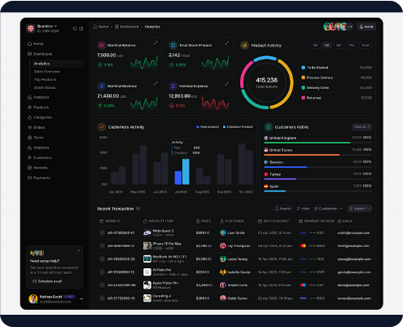
Model Saving & Streamlit App
▹
The highest-performing, finalized model was efficiently serialized and saved utilizing Joblib as churn_model.pkl.
▹
This serialized model pipeline is seamlessly loaded and initialized by the Streamlit web application.
▹
End-users, such as customer success agents, can input live customer details through an intuitive, interactive web form.
▹
The application instantly routes the inputs through the trained pipeline and visually outputs the churn prediction and exact churn probability percentage.

Slide 9




Project Workflow & Results
2. Engineering
4. Deployment
Result: An end-to-end churn prediction system was successfully developed. The deployed system effectively empowers businesses to identify customers at severe risk of leaving.
Feature Preprocessing, Encoding, Scaling, and Train/Test Splitting.
Model Serialization (Saving) and Streamlit Web Application Launch.
1. Preparation
3. Modeling
Dataset Loading, Cleaning, and Exploratory Data Analysis (EDA).
Model Training, Hyper-Evaluation, and Best Model Selection.

Slide 10


Conclusion & Future Scope
Conclusion
Future Improvements
▹
Customer churn prediction acts as a fundamental pillar to support data-driven customer retention programs.
▹
Implementation of extensive hyperparameter tuning and k-fold cross-validation.
▹
This project successfully demonstrates a complete, end-to-end Machine Learning pipeline workflow.
▹
Exploration of advanced ensemble gradient boosting models like XGBoost or LightGBM.
▹
The integrated Streamlit interface bridges the gap between complex data science and practical, easy-to-use business applications.
▹
Integration of Feature Importance and SHAP values for superior model explainability.
▹
Upgrading the web dashboard capabilities and transitioning to scalable cloud deployment (AWS/GCP).

Slide 11
Thank You!
Are there any questions about the churn prediction models or the Streamlit deployment?

